Slide 1
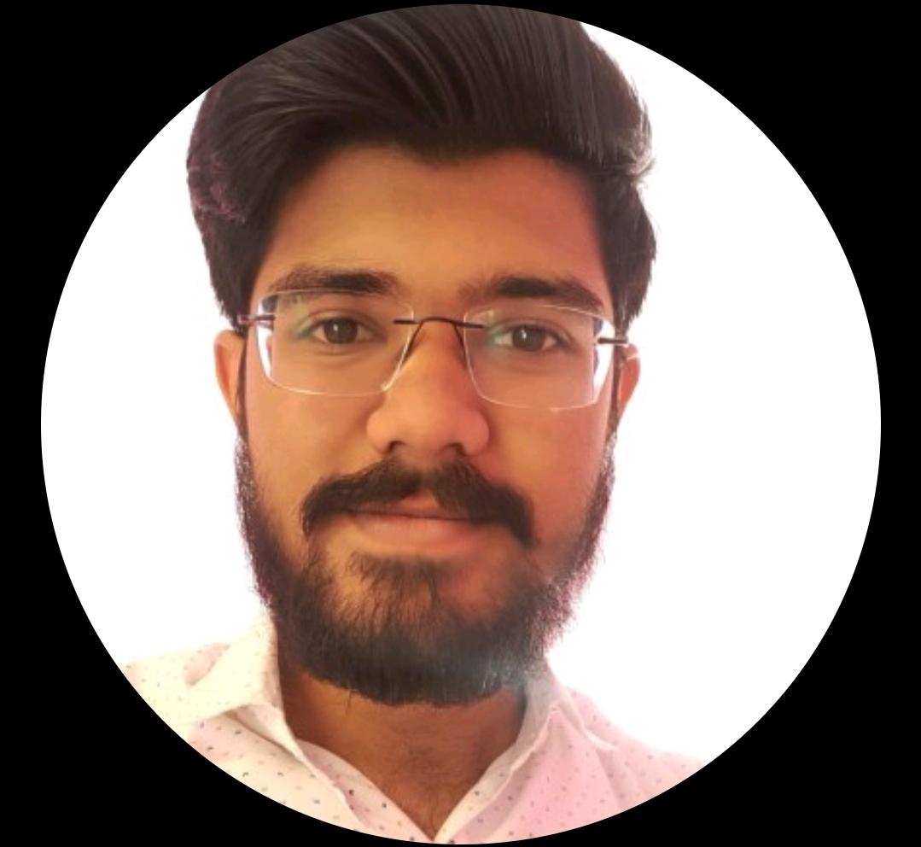

Karan Shah
JAVA FULL STACK DEVELOPER
FTE
RELEVANT EXPERIENCE
As a Java Full Stack Developer, I have
Built and delivered Java full-stack solutions using Spring Boot for backend services and modern UI frameworks (React) for responsive web applications.
Developed and maintained RESTful APIs and microservices, implementing validation, error handling, and API documentation (Swagger v3) for reliable integration.
Designed and optimized data layers using SQL (PostgreSQL/Oracle), including schema design, indexing, and performance tuning.
Implemented security and identity patterns (using Spring Security, JWT, role-based access control) to meet enterprise compliance needs.
Led incident reviews and root cause analysis (RCA), driving preventative fixes and reducing recurring production issues through actionable remediation plans.
Collaborated effectively in Agile/Scrum teams, partnering with product, QA, and platform teams to deliver incremental value and client-ready outcomes.
Improved reliability by instrumenting applications with logs, metrics, tracing using tools like Splunk and aligning monitoring to SLA targets.
+91 96533 10060
kshah13@deloitte.com
Mumbai, India
RELEVANT SKILLS
Karan has 4,5+ years of experience as a Java Full Stack Developer. Proficient in Java Full Stack, React, AWS Glue, BedRock, Open AI, AWS Serverless. Skilled in designing and building scalable, secure Java-based full-stack applications, with hands-on experience across backend services, RESTful APIs, and modern web UIs. Proven ability to deliver robust, maintainable solutions by leveraging Spring Boot, microservices, while collaborating effectively in Agile/Scrum environments.
Languages : Java, React, AWS Glue, BedRock, Open AI, AWS Serverless
Frameworks : Spring Boot, Hibernate – JPA, TS
Database : PostgreSQL, Oracle SQL
Testing & Scripting : Spock-Groovy scripts
Project & Collaboration Tools : JIRA, Confluence, IntelliJ, VS Code, Gitlab
EDUCATION/CERTIFICATIONS
Mumbai University, India, Bachelor of Engineering- Computer Science
REPRESENTATIVE CLIENTS
Charter Communications

